Slide 1
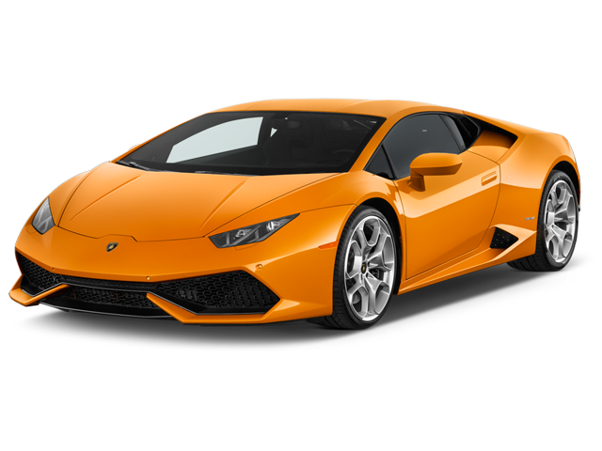
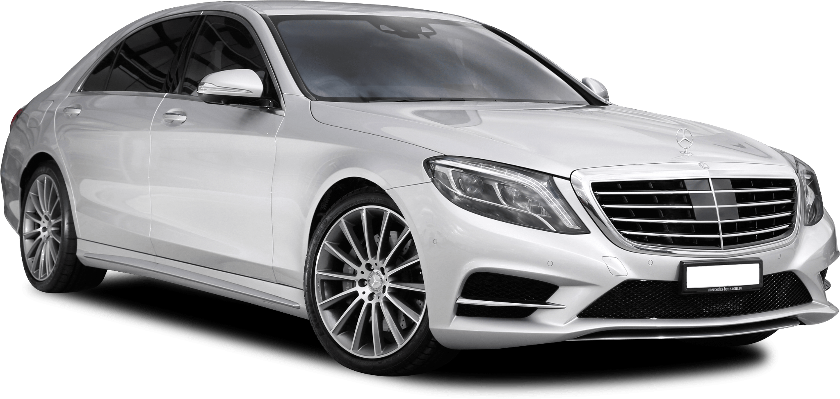
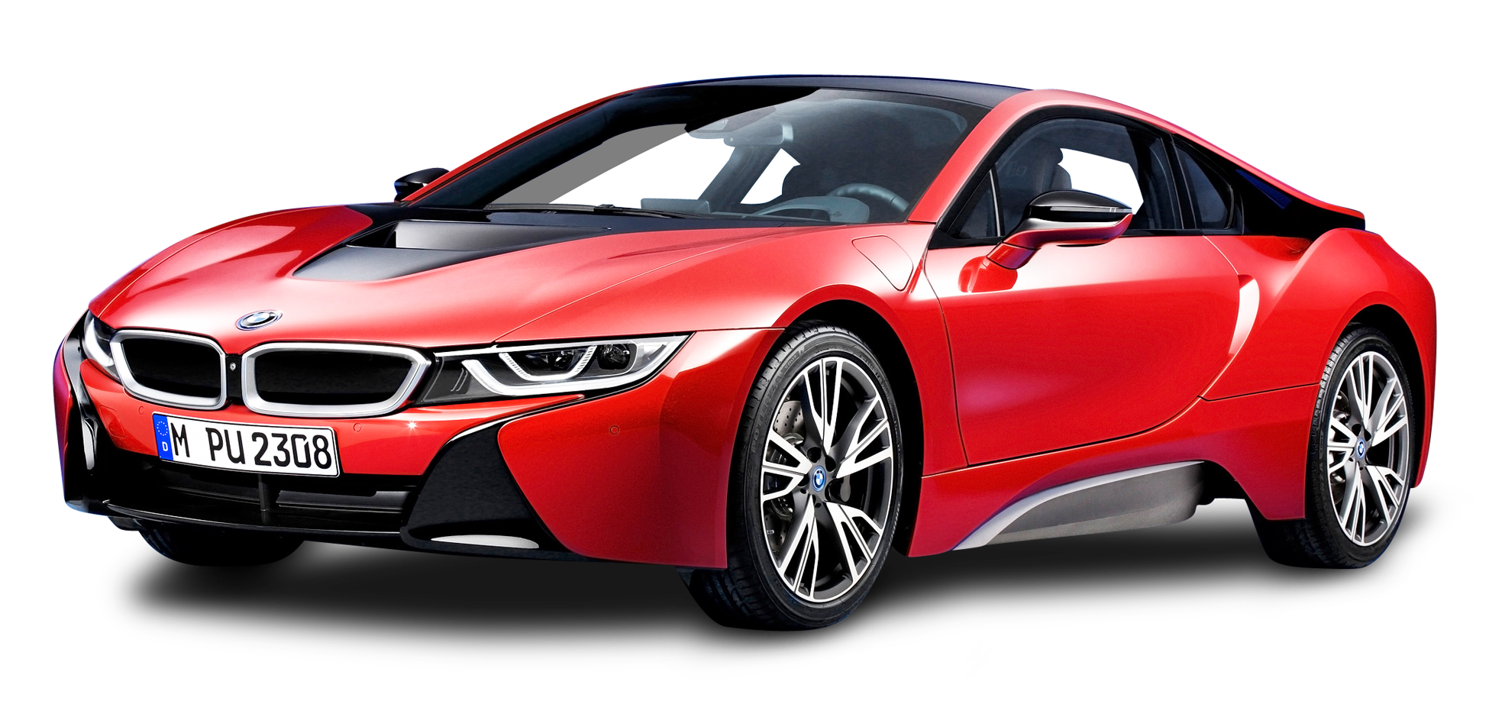
Cars 4 Sale
By:
Anil Kumar Kamani
Venkata Naga Dinesh Kumar Desai
Shyam Jonnalagadda
Git URL : https://github.com/venkatanagadinesh/car_price_prediction

Slide 2
Tools and Technologies
Backend : Python, Flask
Front end : ReactJS
DB : SQLite

Slide 3
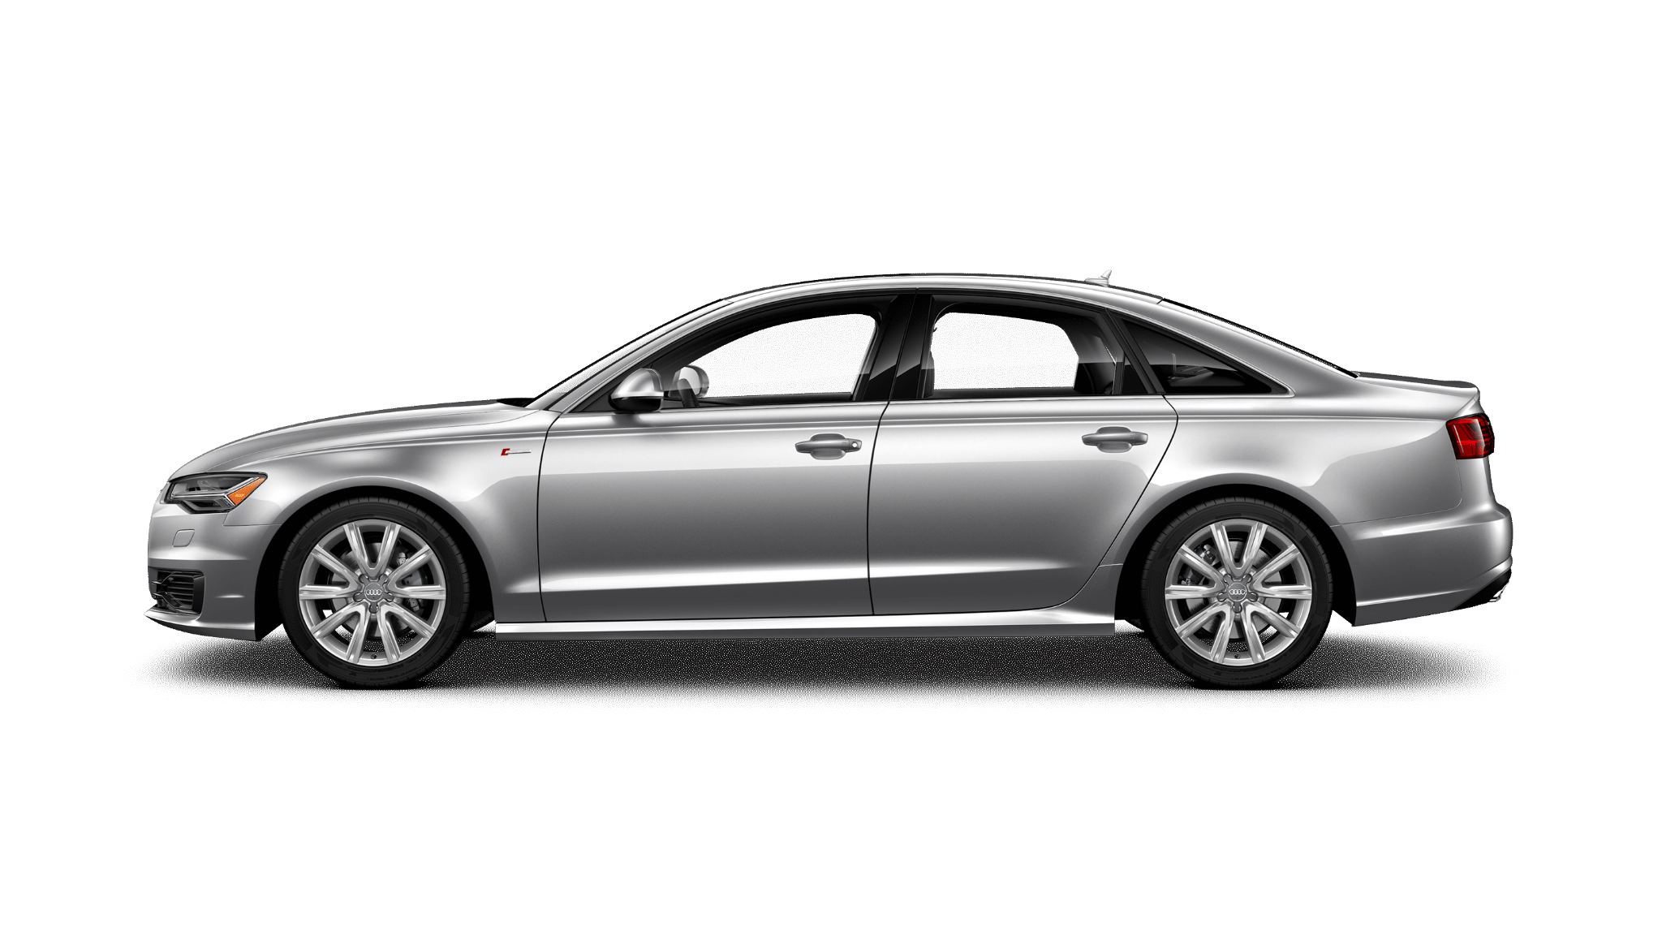
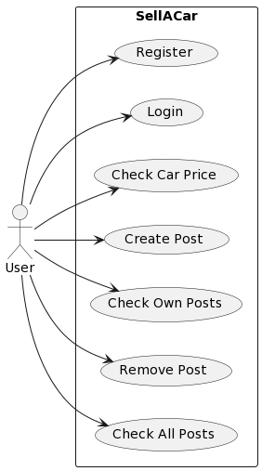

Use Case Diagram

Slide 4
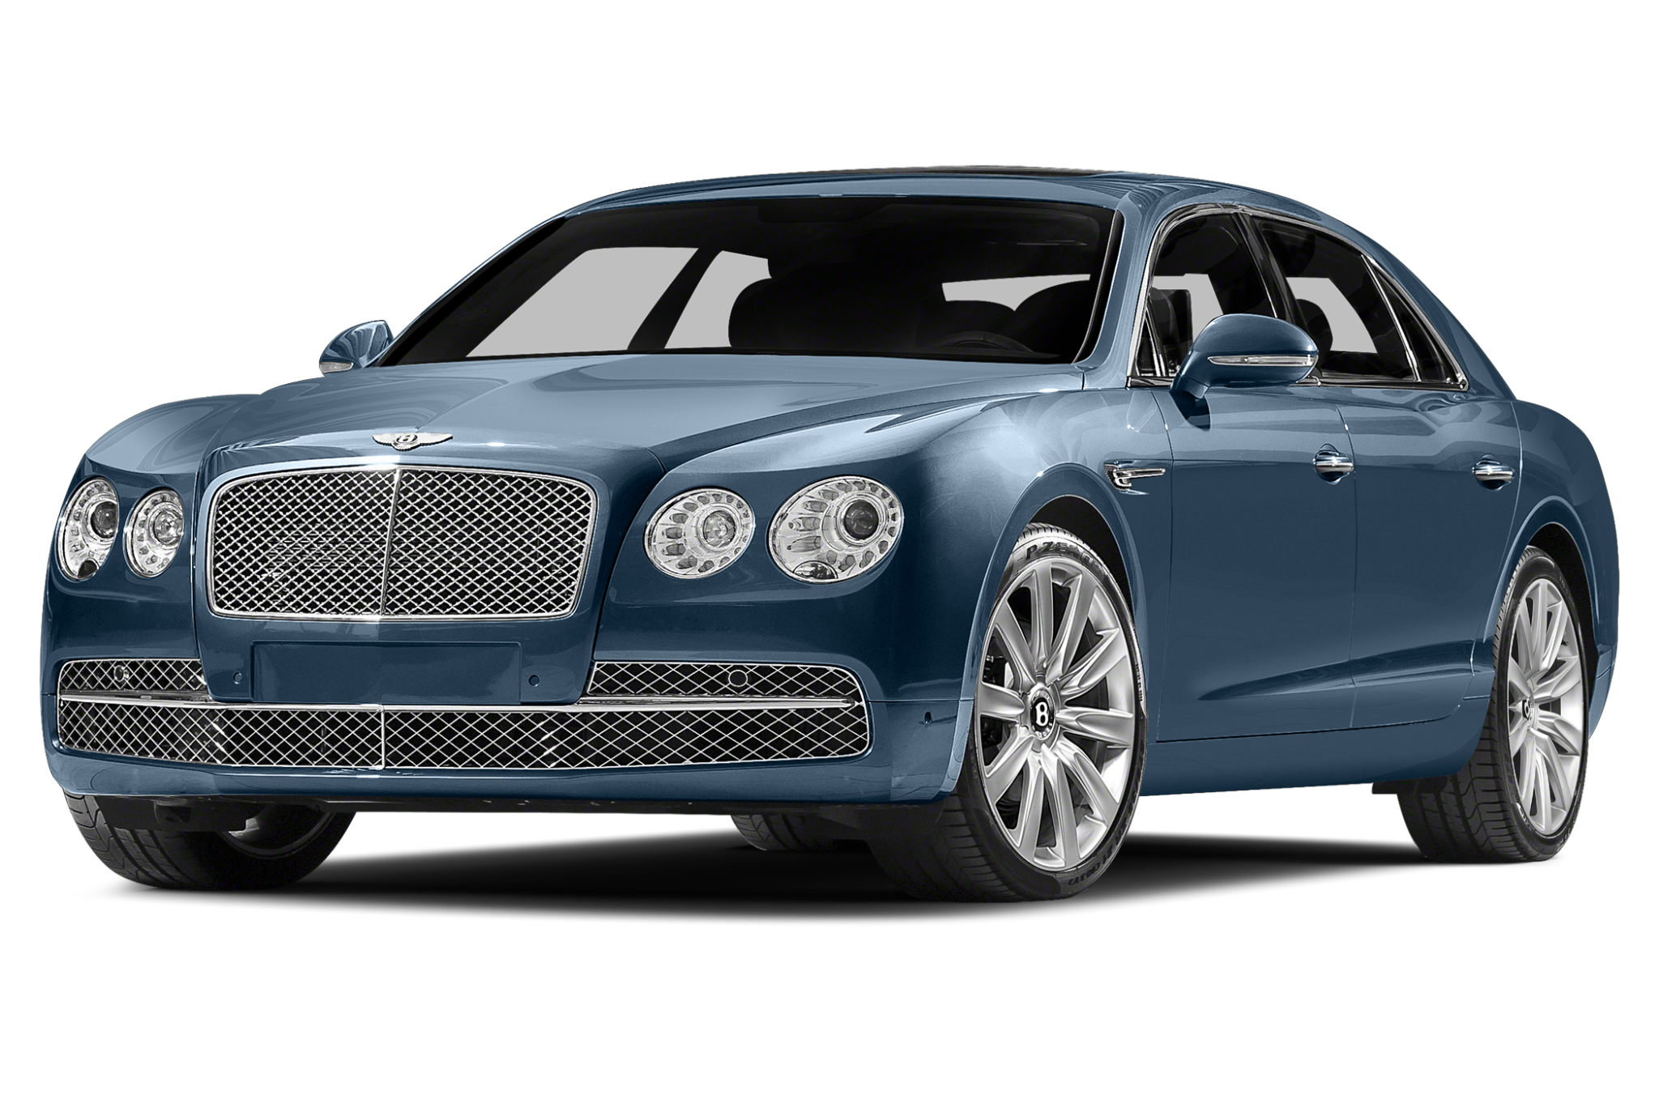
Description
In this use case diagram, we have one actor named "User" and six use cases those are Register, Login, Check Car Price, Create Post to Sell Car, Check own posts, and Buy Car. All these use cases are within the scope of the Website.. The arrows show the interactions between the actor and the use cases.
Actors :
User : User can register, login, sell a car, buy a car, check car price prediction.

Slide 5
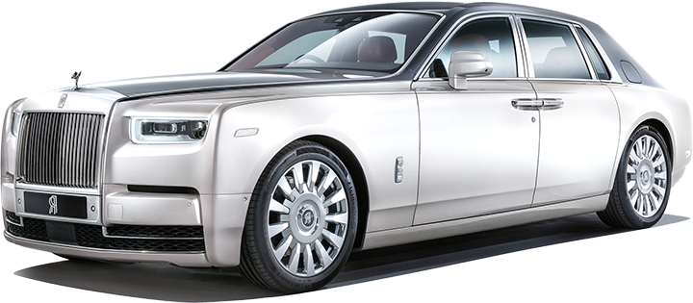
Description
Use Cases :
Register : User can create account in the application.
Login : User can login to his account.
Car price : User can predict the price of his car to make decision.
Create a post to sell car : User can post an ad to sell his car.
Check own post : User can manage his posts.
Buy Car : User has an option to check the posts and buy a car.

Slide 6
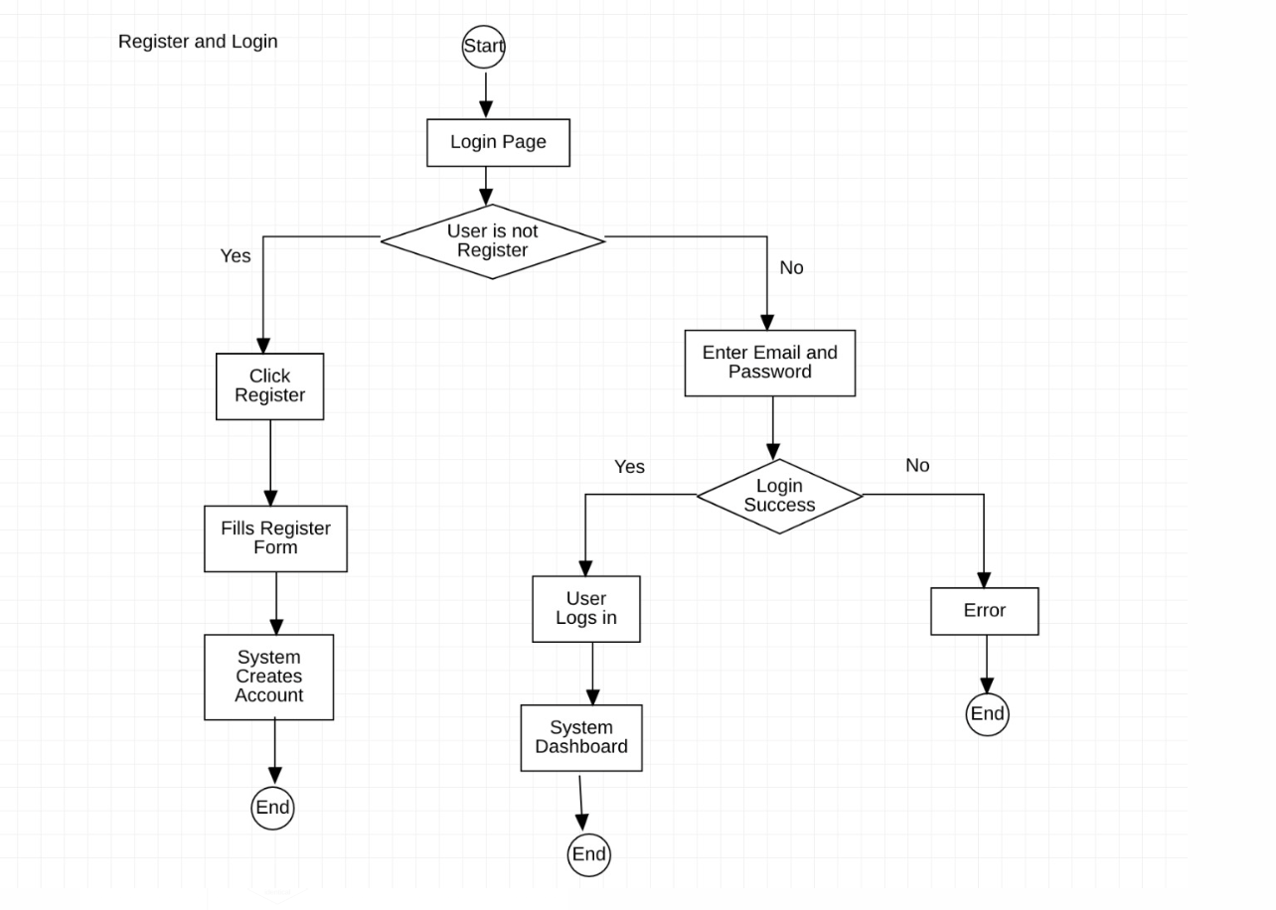
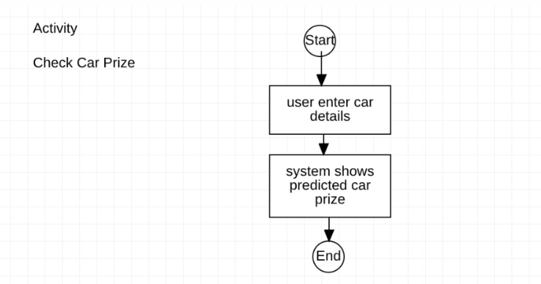
Activity Diagram

Slide 7
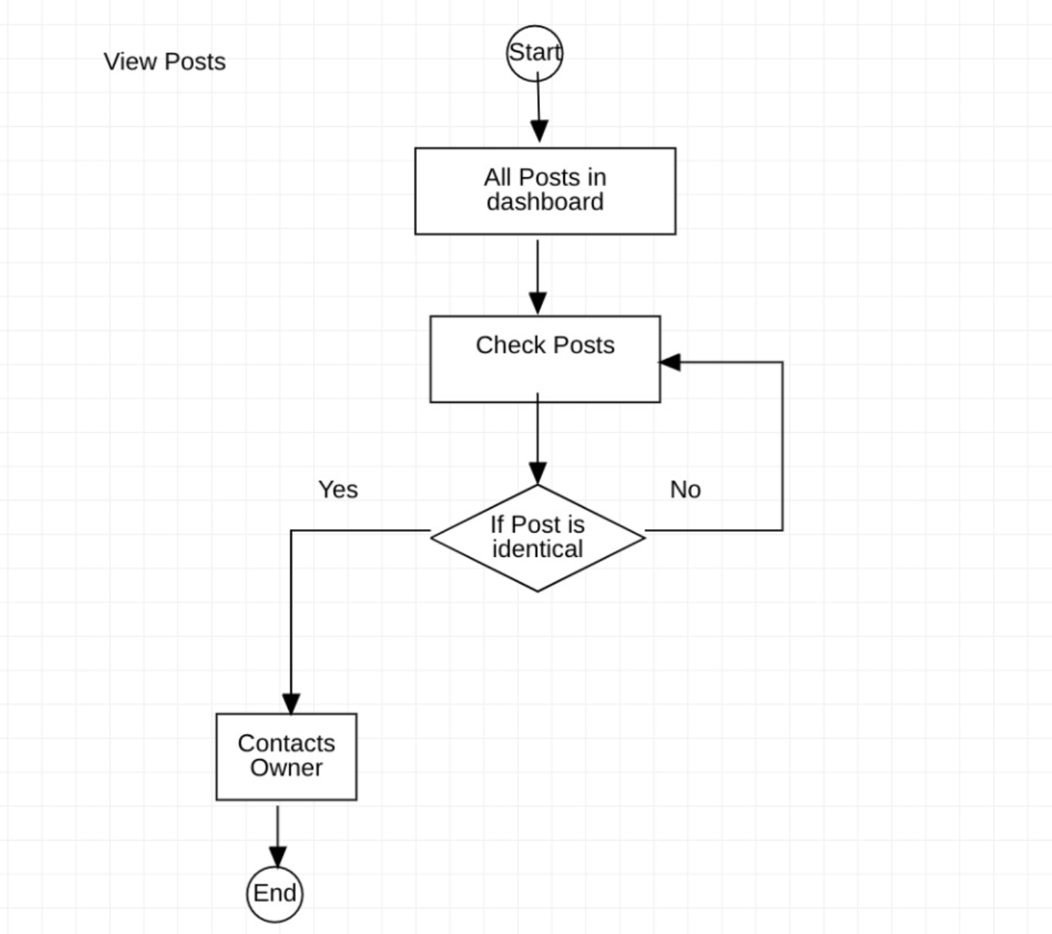
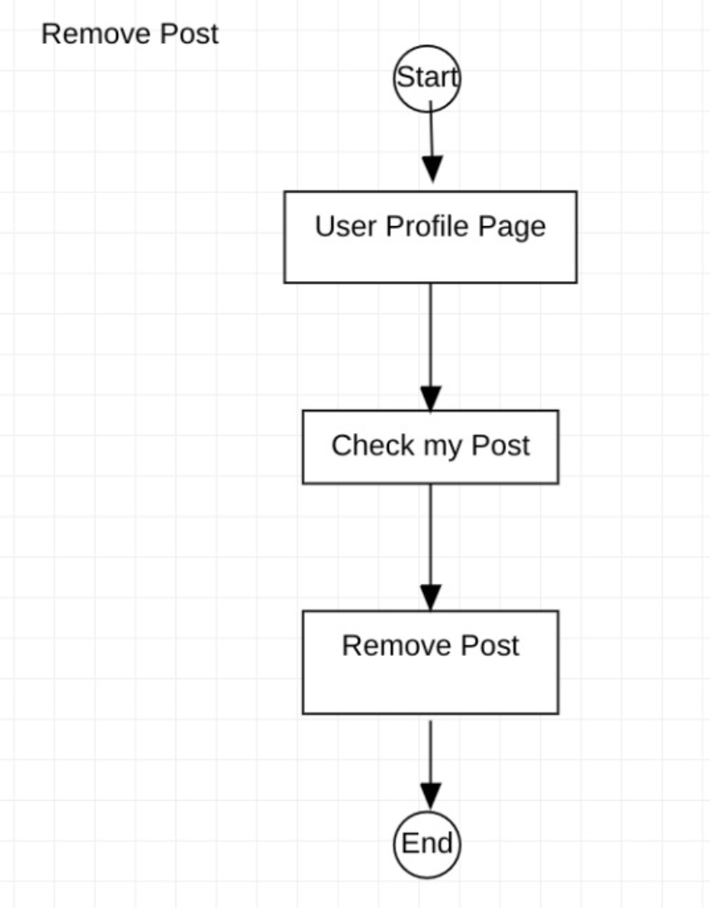
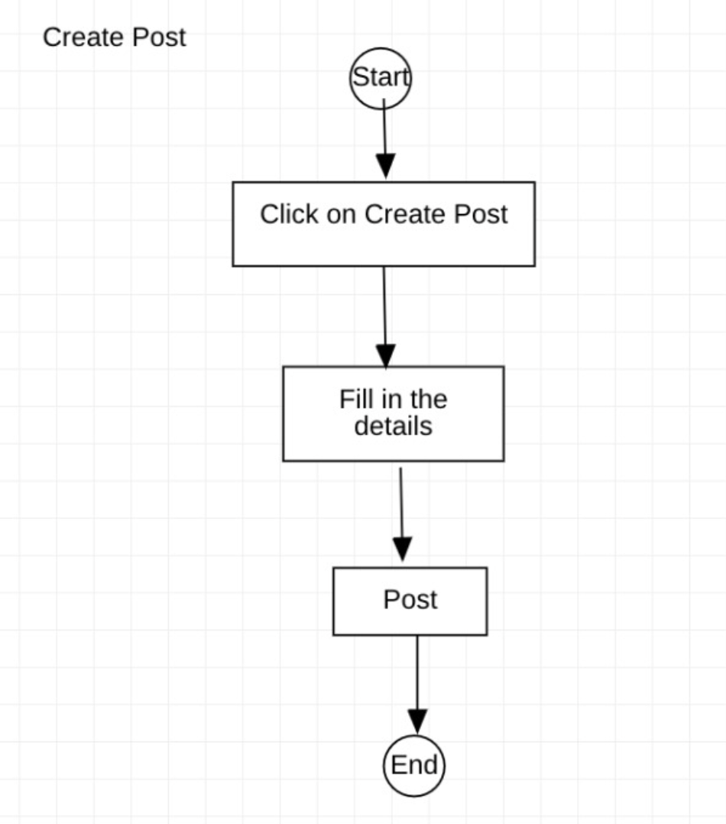
Activity Diagram (cont’d)

Slide 8
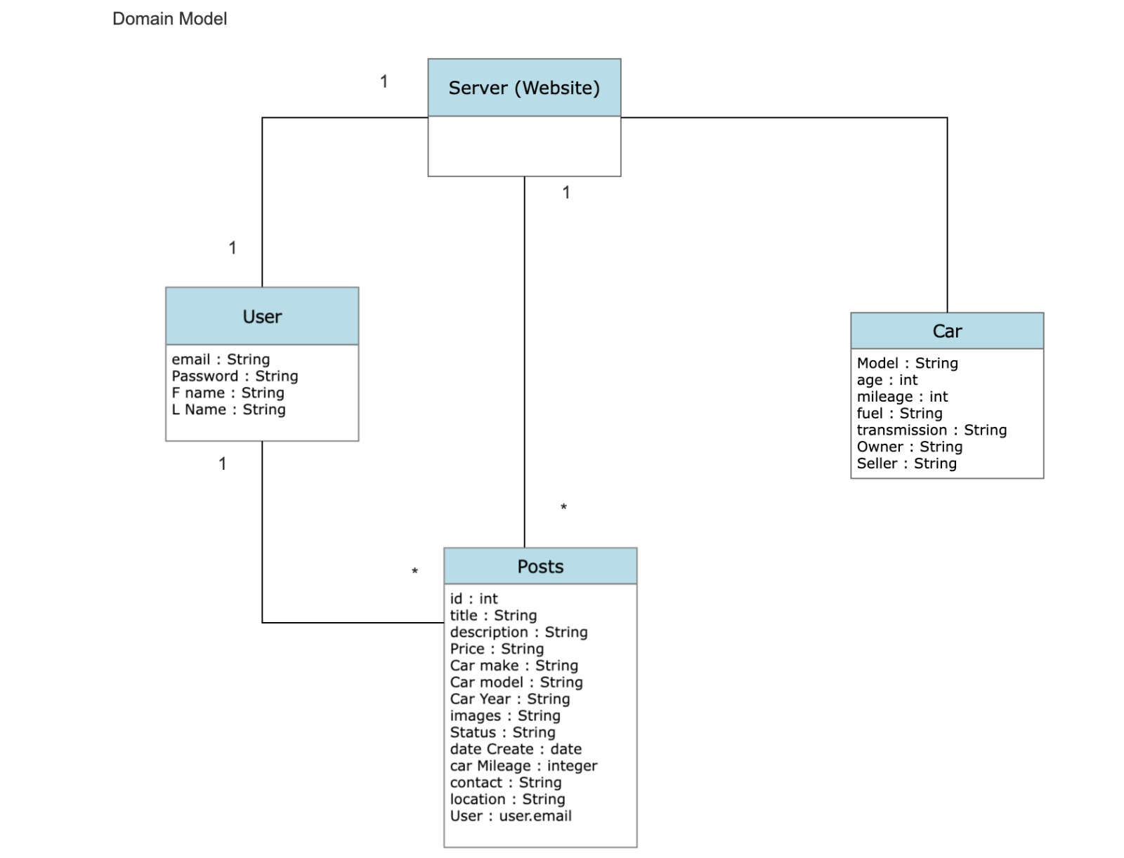
Domain Model Diagram
The User class represents a user of the system.
The Car class represents a car that can be bought or sold on the system. The Car class is also associated with the Post class through a one-to-many relationship, meaning that each post can be associated with one car, but a car can be associated with many posts.
The Post class represents a post that a user can create to sell a car on the system.The Post class is also associated with the User class through a one-to-many relationship, meaning that each post can be associated with one user, but a user can create many posts.
The SellACar class represents the overall system.

Slide 9
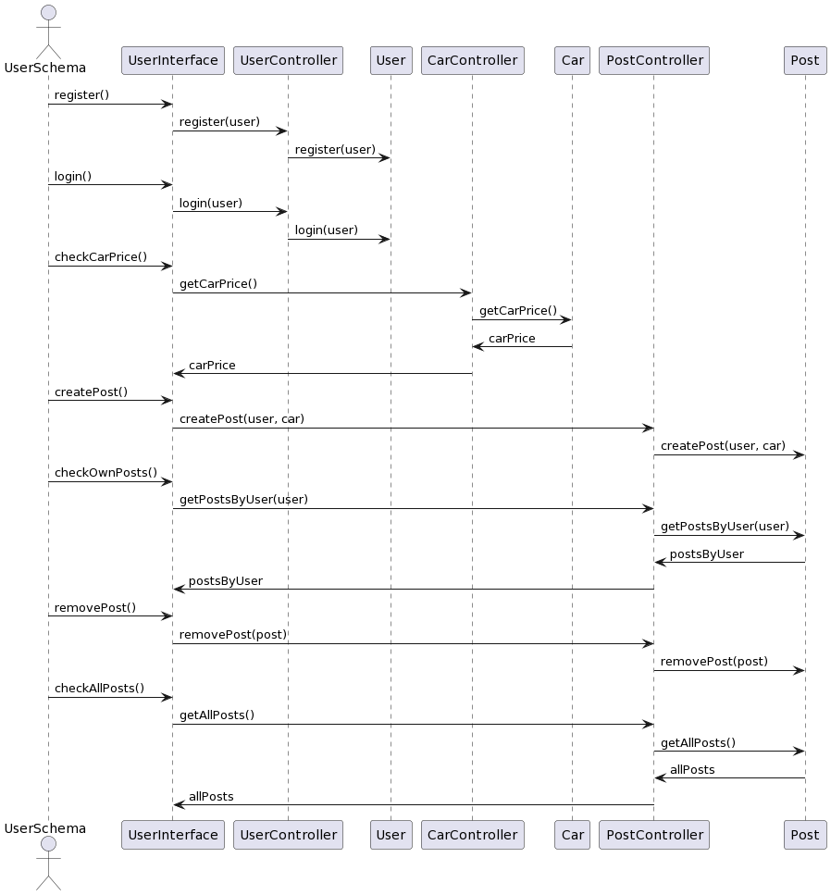
Sequence Diagram

Slide 10
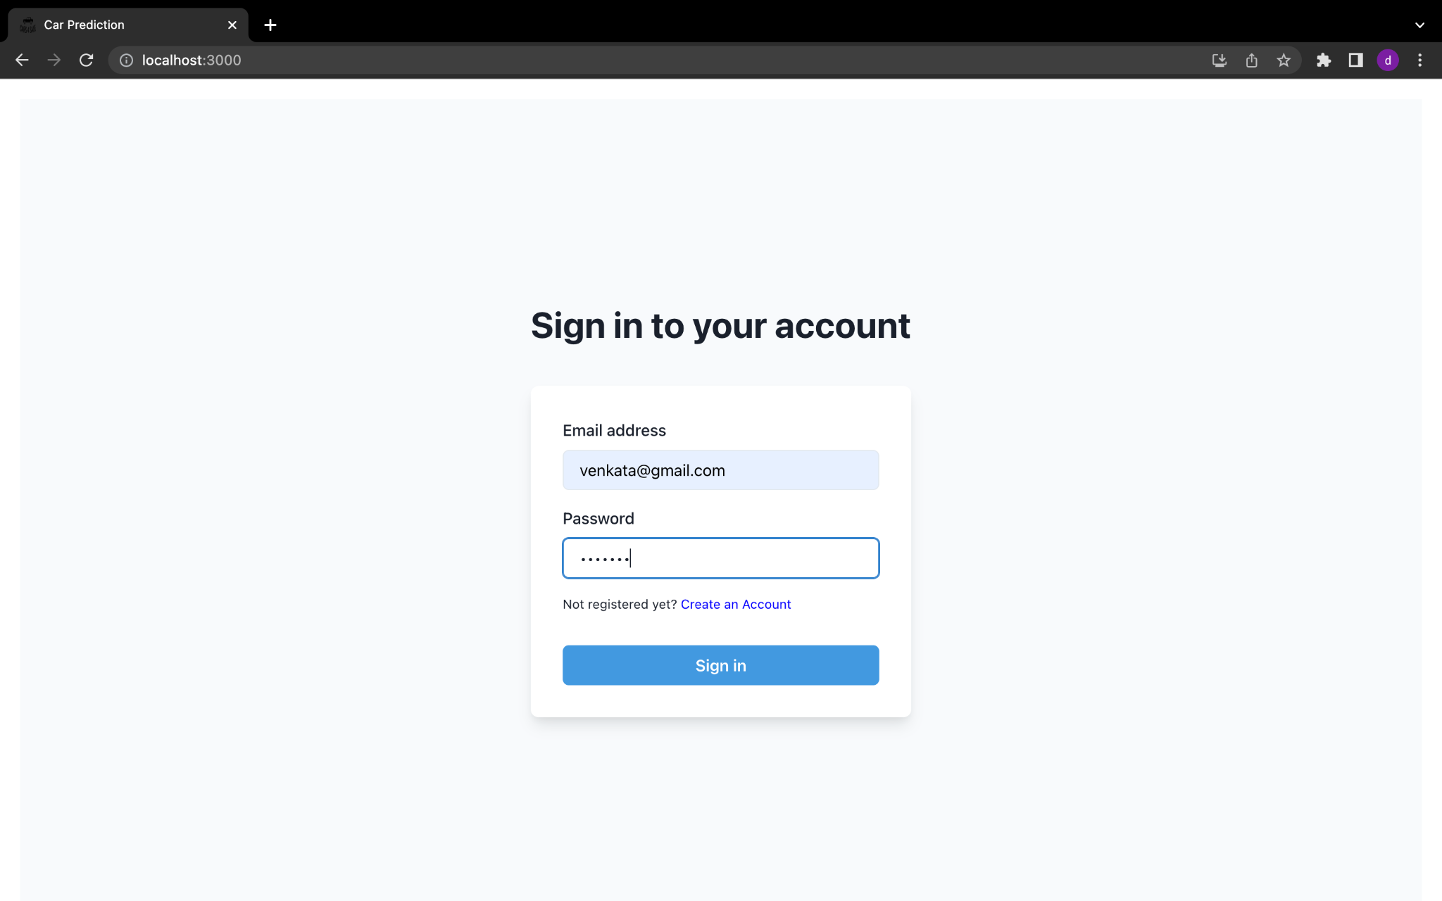
Login Page

Slide 11
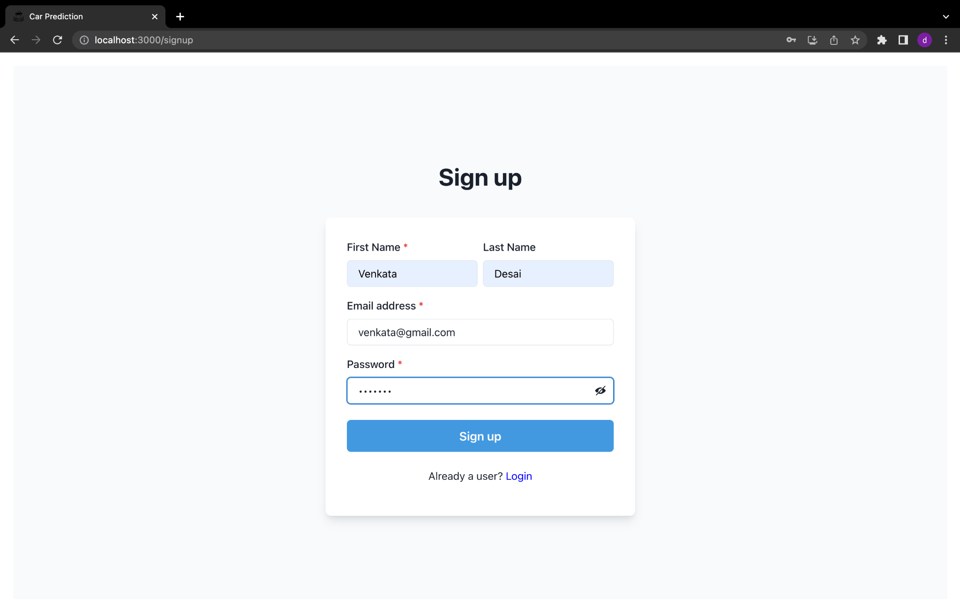
Register

Slide 12
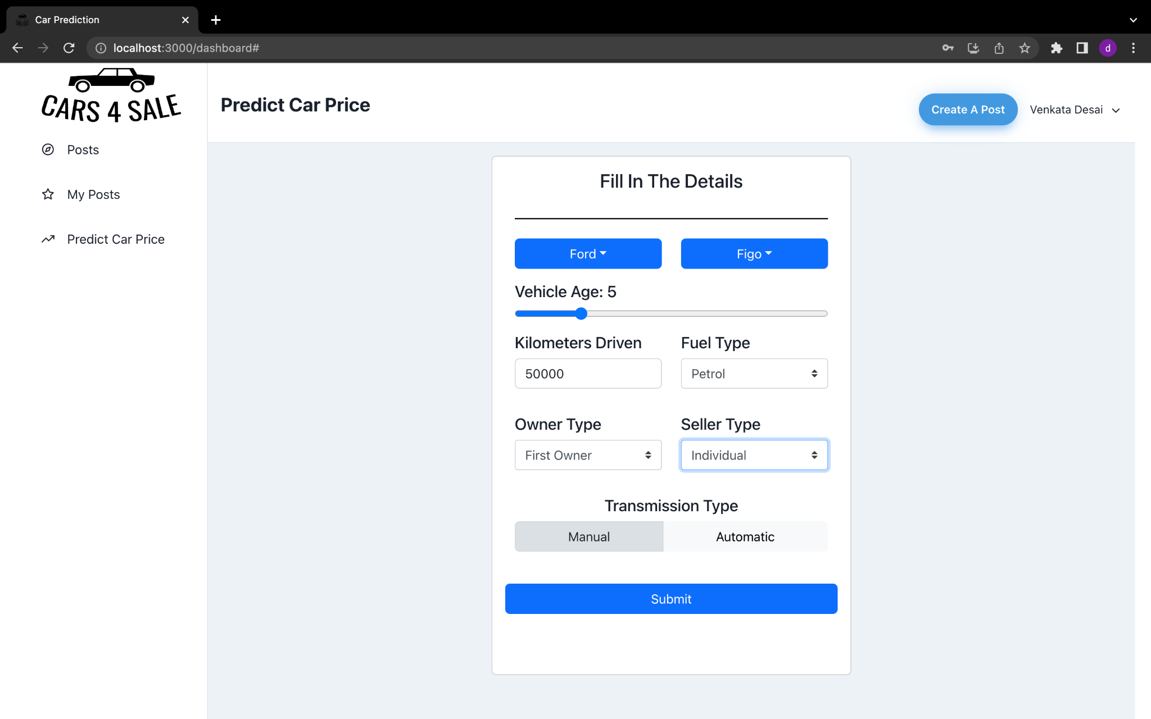
Car price predict

Slide 13
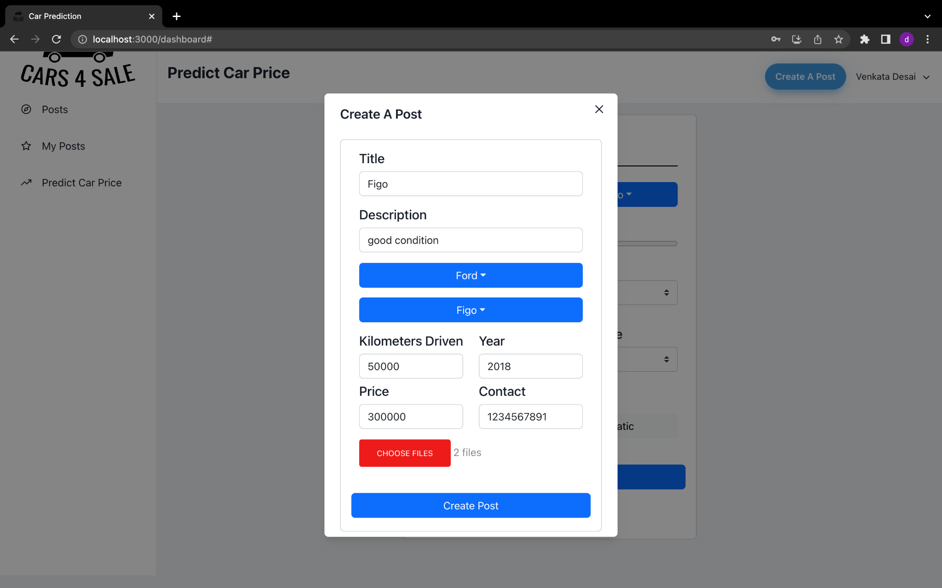
Create Post

Slide 14
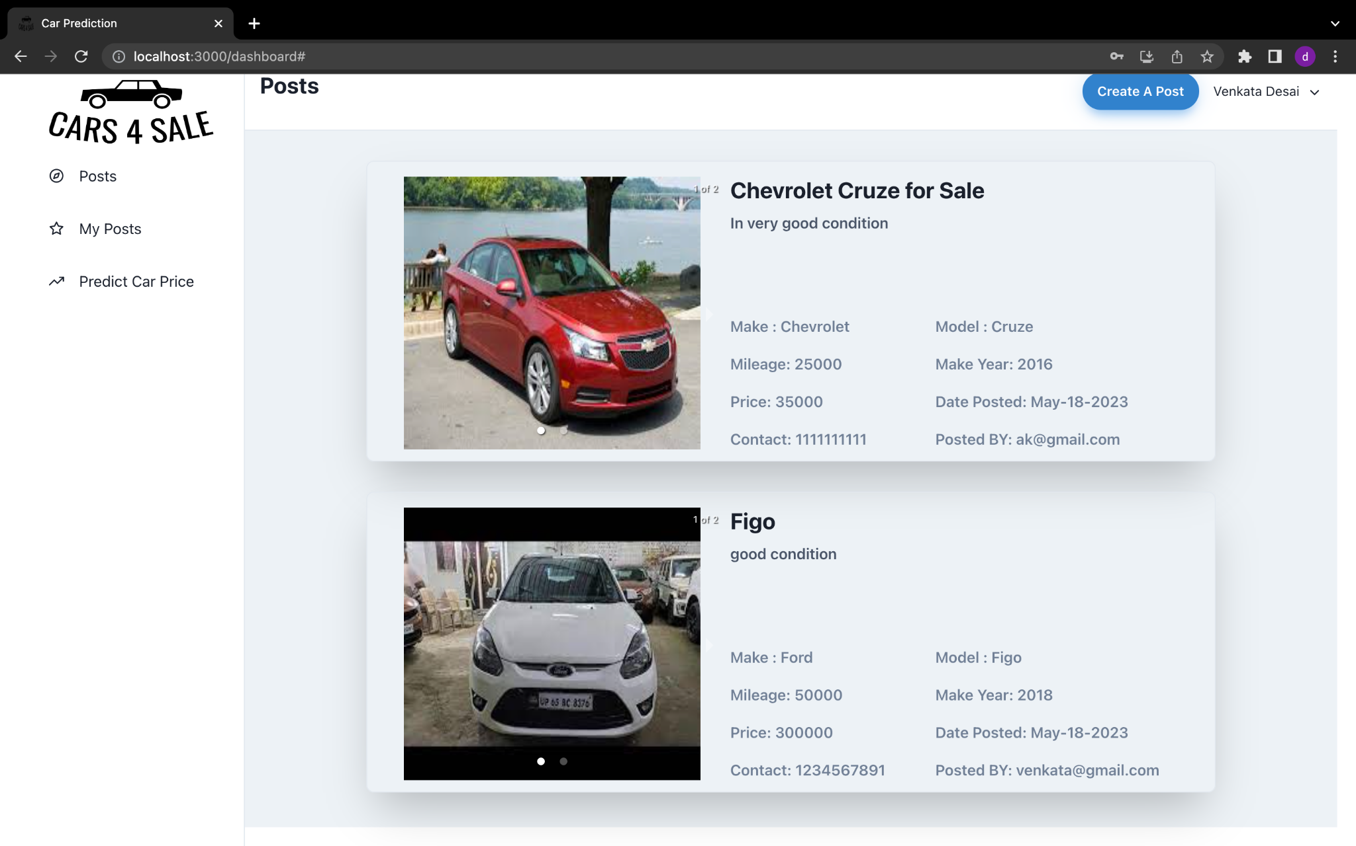
Dashboard

Slide 15
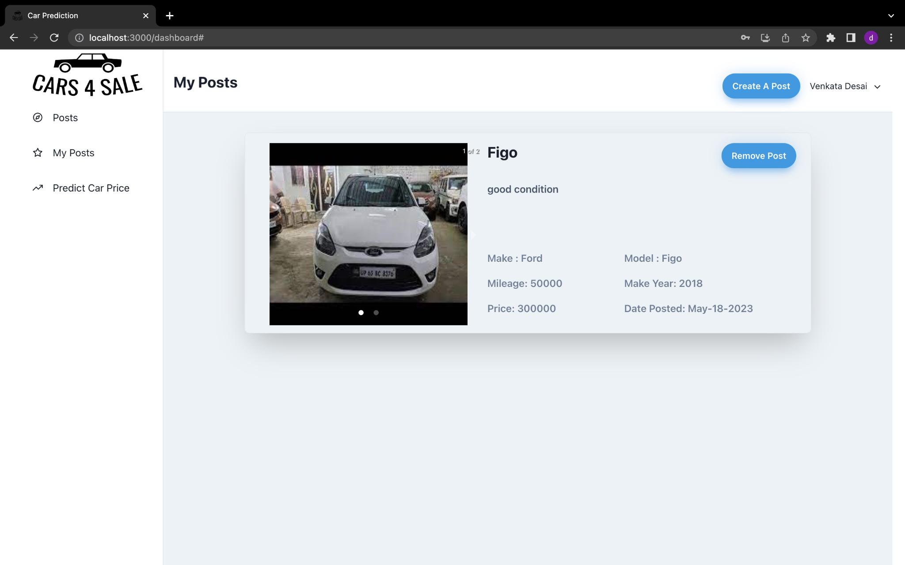
My Posts

Slide 16

